Slide 1
team 5: safe
Markus Schwörer, Florian Bregle, Frank Mutter

Slide 2
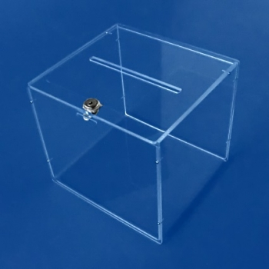
safe building
wooden box; glueing acryl glass on top of it
Use acrylic glass and a cnc mill
Use a donation box like in the picture
-> replace the existent lock by electronic lock
https://displayzentrum.net/images/product_images/info_images/losbox-schloss_2091_0.jpg; 7.11.19

Slide 3
Puzzle - general idea
safe has first to be connected to power lines -> one or two puzzles
Puzzles with „electronical“ background
puzzle to open the safe -> one or two puzzles
=> Combine puzzles

Slide 4
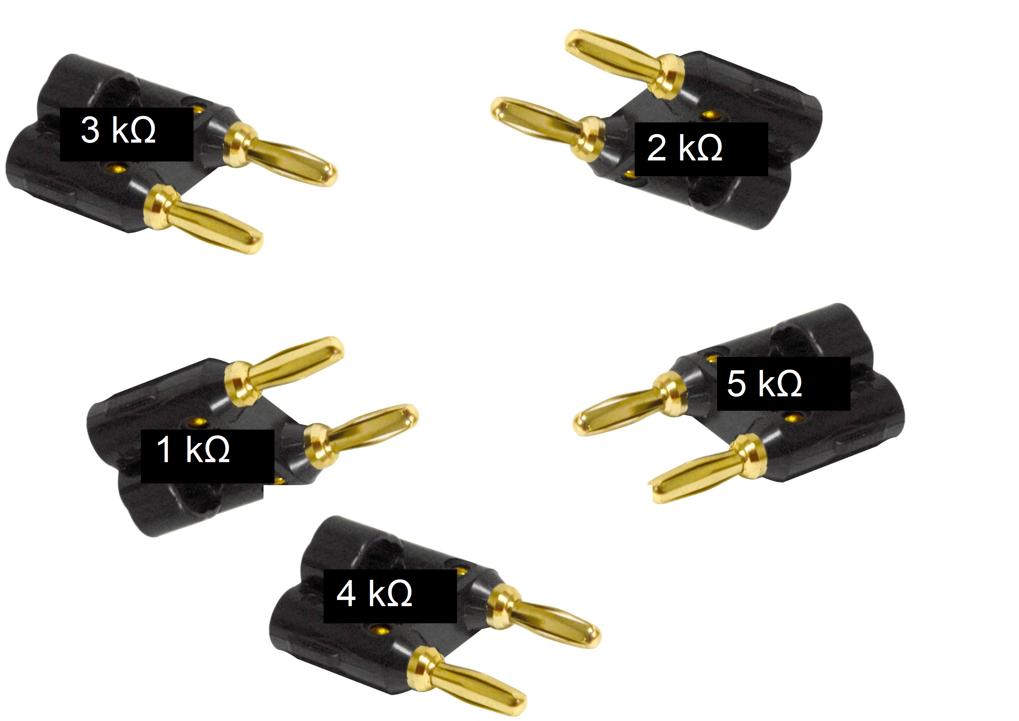
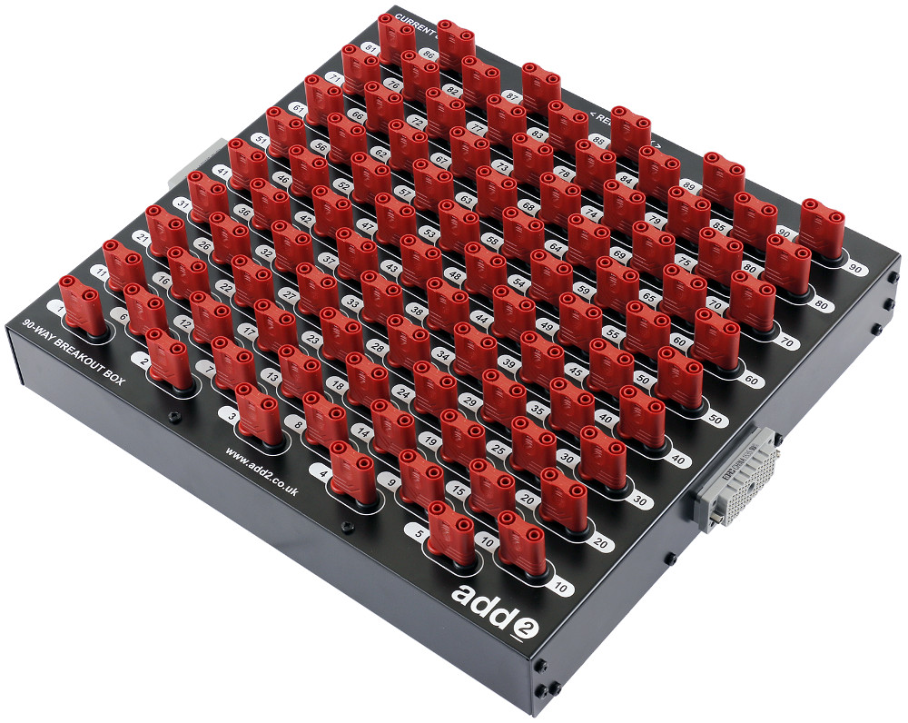
possible puzzles to activate the safe
Find the correct resistor to generate the correct voltage
Labelled with resistance
Array of banana jacks

Slide 5
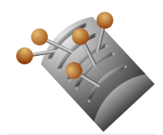
possible puzzles to activate the safe
Switching levers in correct order
multiple puzzles with boolean answers

Slide 6
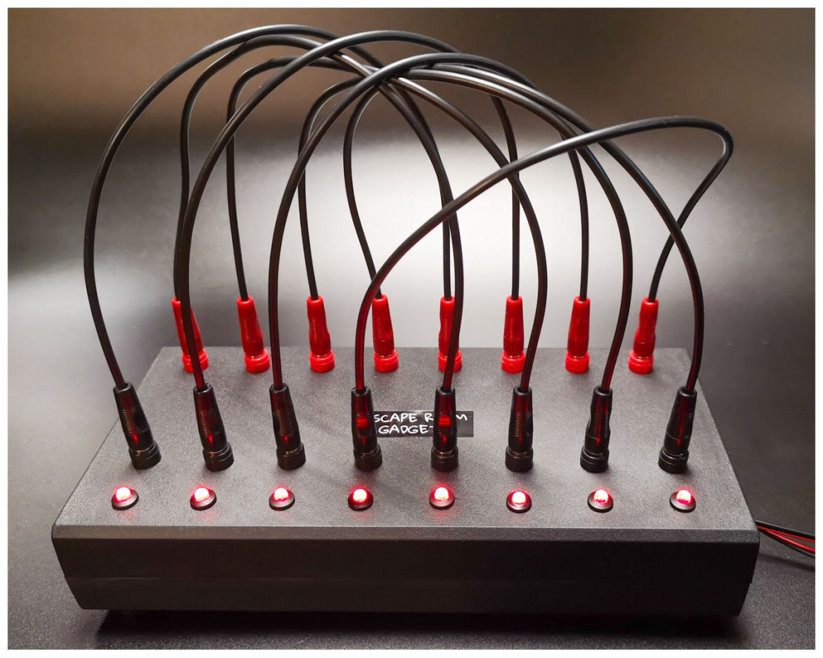
possible puzzles to activate the safe
Wiring cable riddle

Slide 7
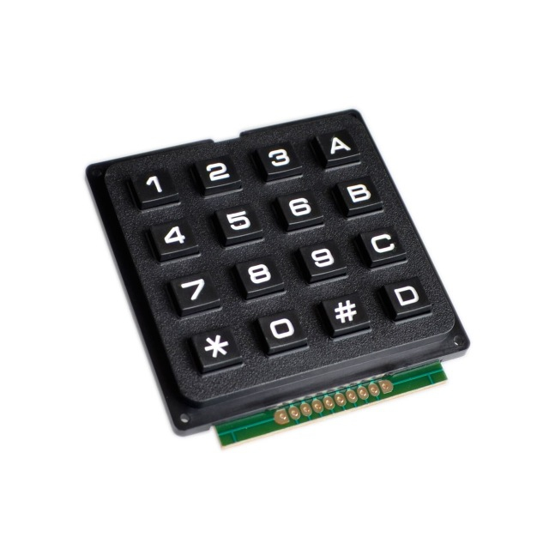
possible puzzles to open the safe
Riddle with numpad input
Any riddle with a integer solution possible

Slide 8
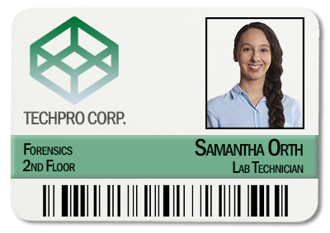
possible puzzles to open the safe
Find ID card of lab employee
Alternatively: magnetic stripe card
Trick face recognition
Use NFC or QR Code for checking

Slide 9
possible puzzles to open the safe
Other ideas:
Reach score in a little video game
Hard to fit in the story
Activate sensor by using laser and movable mirrors

